Slide 1
Rapid Survey Through Call on Screen Mode
Statistics and Informatics Division
Ministry of Planning

Slide 2
Introdiction
The Statistics and Informatics Division has been formulated innovation Action Plan 2020-21 for the implementation of the Government of Bangladesh Vision 2021 and 2041.
Necessary steps were taken to take innovative initiative called “Rapid Survey Through Call on Screen Mode” as part of the activities described in Index 6 of the innovation action Plan 2020-21.
In view of this, an office order was issued on 10-12-2020 to implement the piloting of the innovative initiative "Rapid Survey Through Call on Screen Mode" for the implementation of Innovation Action Plan 2020-21 performance Index 6.1.1.

Slide 3
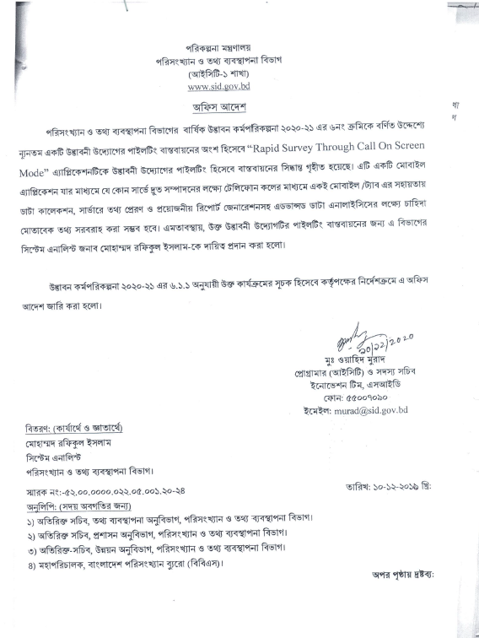
Introdiction
Office order for the implementation of Innovation Action Plan 2020-21 performance Index 6.1.1.

Slide 4
Introdiction
Subsequently, the piloting implementation of the innovative initiative was evaluated on 28-09-2021 according to the performance index 6.2.1.
Currently the innovative initiative “Rapid Survey Through Call on Screen Mode” is being used successfully by all the officers / employees of the Statistics and Informatics Division.

Slide 5
What is this about?
☛ This is a Mobile/Tab application
☛ It is mainly a CAPI system.
☛ Survey Interview Completed Through Phone Call.
☛ Phone call is generated from the application.
☛ During Covid Pandemic this application is really handy to complete survey through phone call.
☛ Survey sample can easily be distributed among interviewers.
☛ Partial interview nicely handled.
☛ possible to provide on-demand information for advanced data analysis including data collection, transmission of data to the server and preparation of necessary reports

Slide 6
What are challenges…..
Challenges
☛ During Covid pandemic, completing a survey in quickest time is a challenge.
☛ Manual survey using PAPI is time consuming.
☛ Processing survey result from PAPI is more time consuming
☛ Managing survey samples in paper is problematic.
☛ Managing partial interviews also a challenge.
Notes:
Describe what you and the team worked on last month.

Slide 7
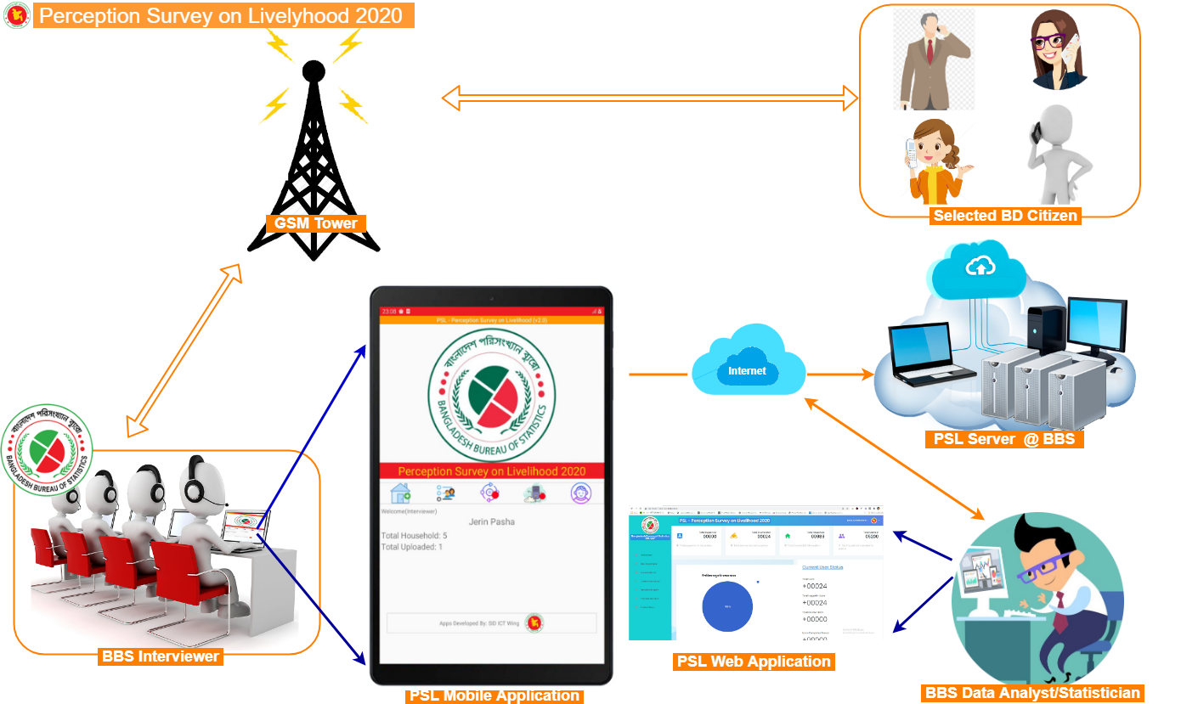
How the Rapid Survey System Works!
How it works
Notes:
Describe what you and the team worked on last month.

Slide 8
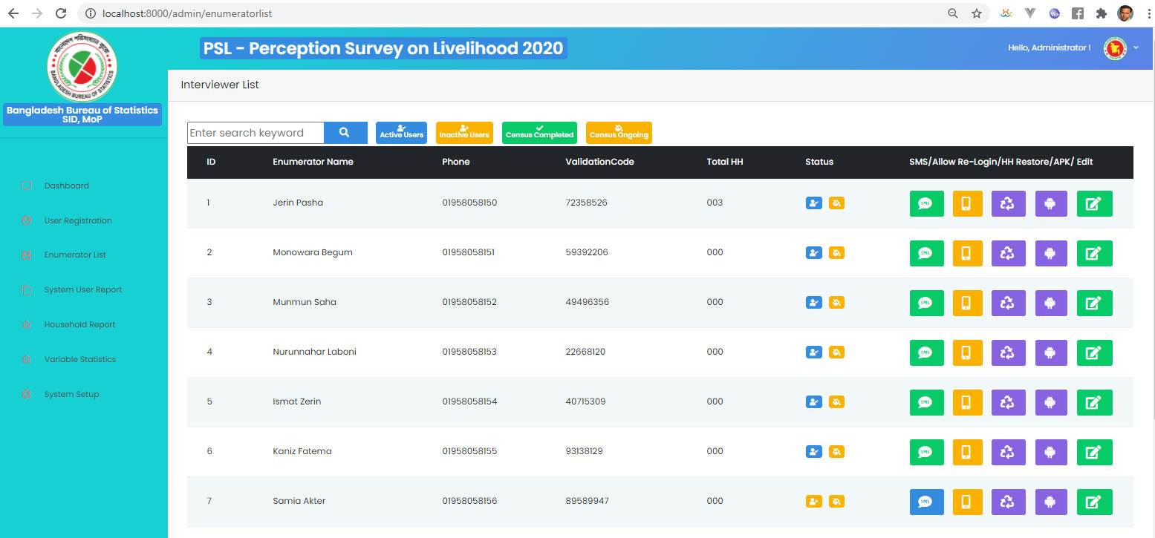
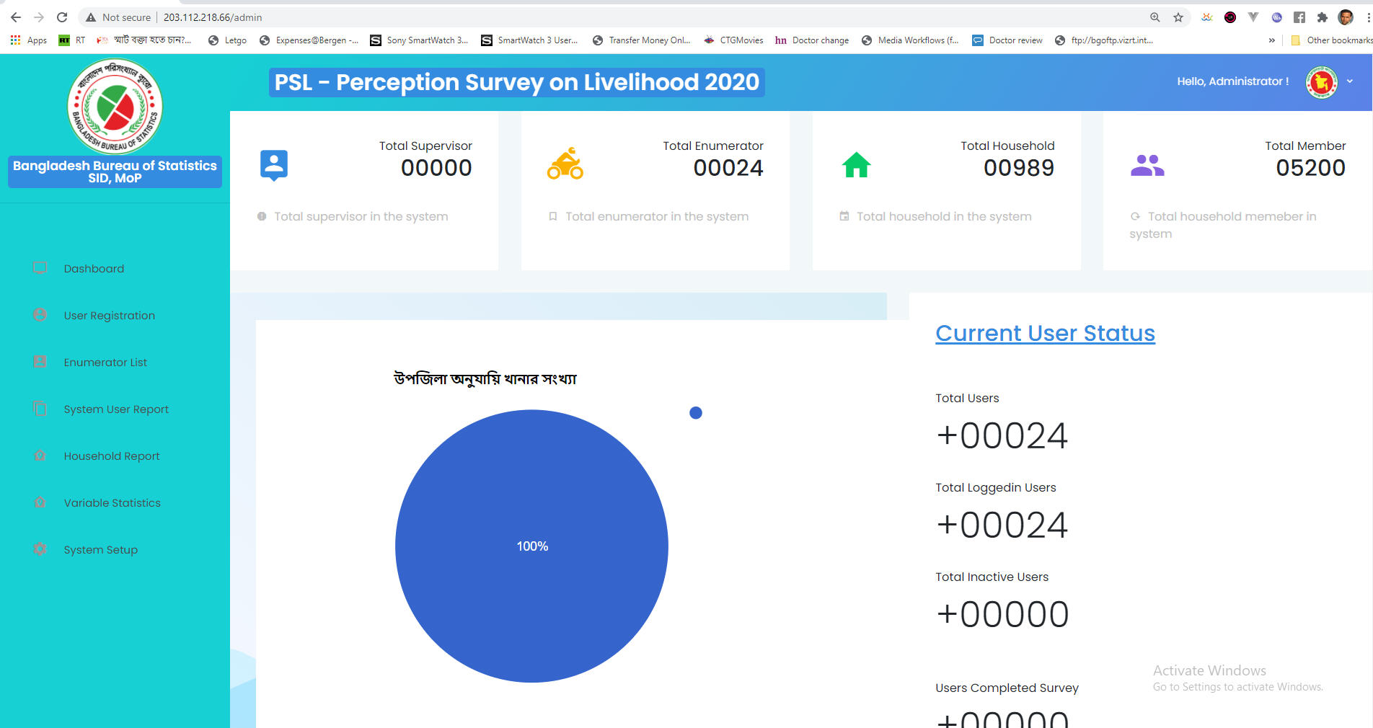
Solutions (Web Application)
How it works
Notes:
Describe what you and the team are planning to work on next month

Slide 9
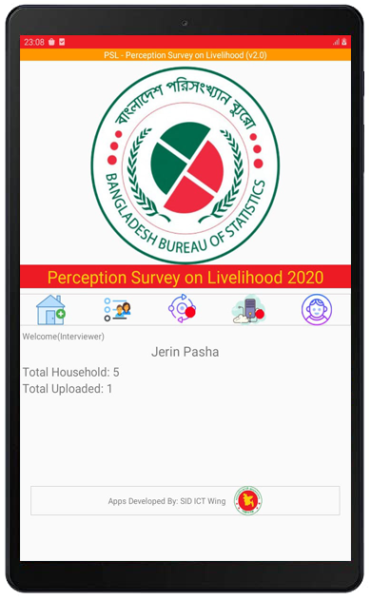
Solutions (Tab/Mobile App)

Slide 10
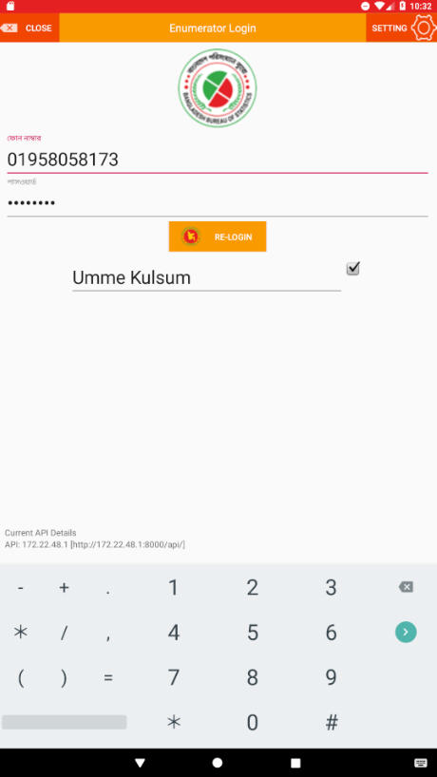
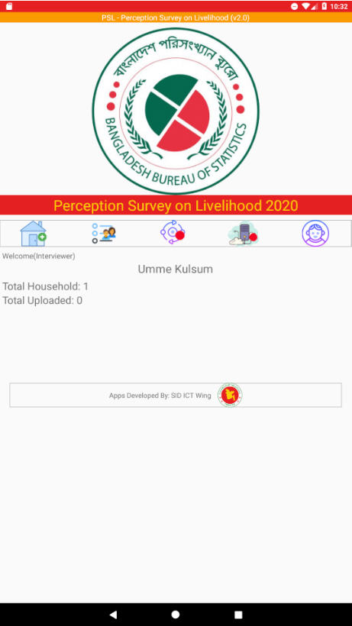
Solutions (Tab/Mobile App)

Slide 11
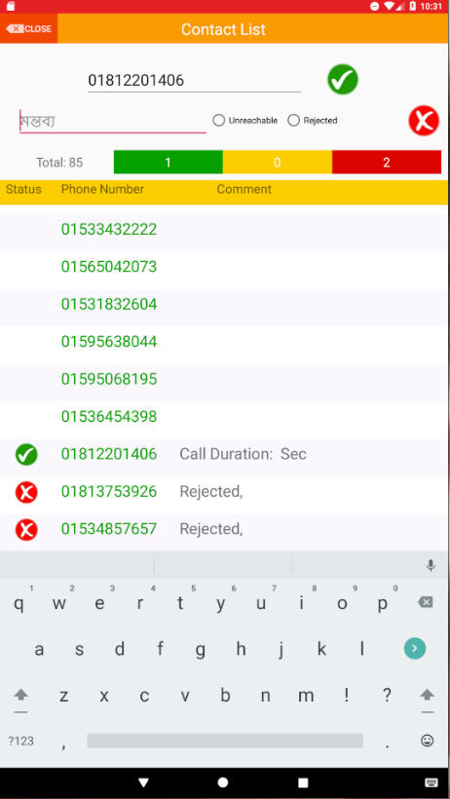
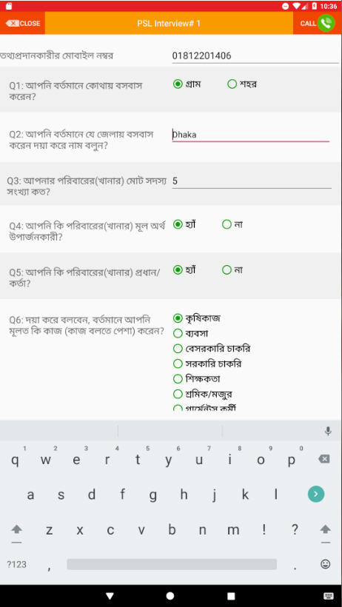
Solutions (Tab/Mobile App)

Slide 12
TCV (Time, Cost & Visit)
TCV++
☛
Who are the target users?
☛ SID & BBS
Is it replicable?
☛ Yes, this is easily replicable in any office.
 | Time | Cost | Visit | Quality
Before this innovation | 3-6 months | ~1,000,000 | Lot of visits(depends on survey type) | Good
After this innovation | 3-4 weeks | ~0 | Minimum | Excellent
Notes:
Describe what you and the team are planning to work on next month

Slide 13
☛ This application achieved 1st position at Innovation Showcasing held at 9th May 2021.
Notes:
Describe what you and the team are planning to work on next month

Slide 14
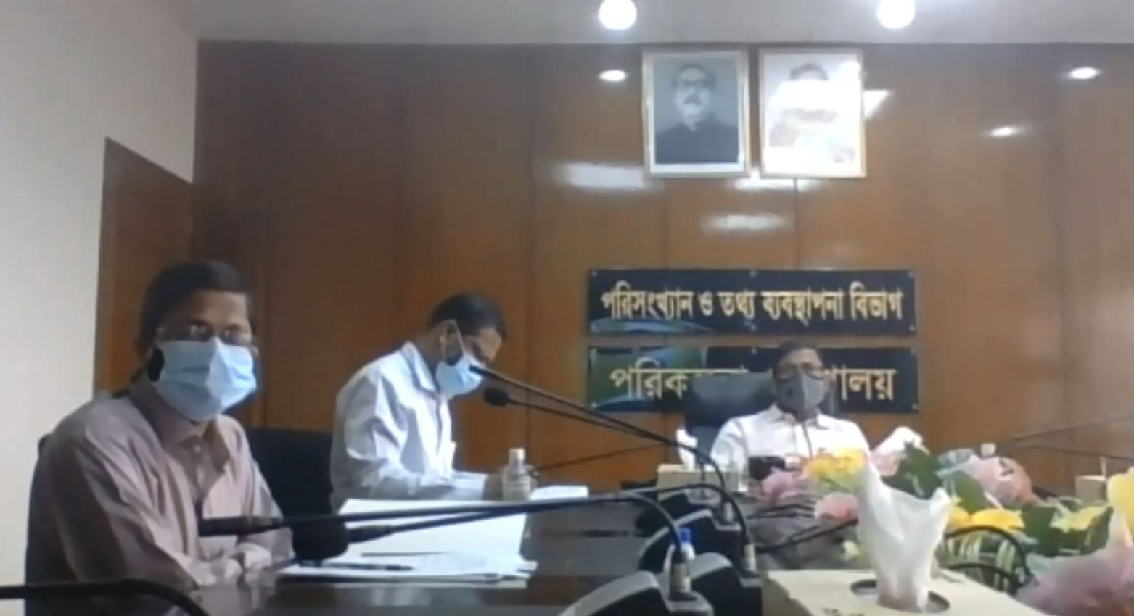
Innovation Showcasing Program:
Notes:
Describe what you and the team are planning to work on next month

